Slide 1
How To Order Books ONLINE BOOKSTORE
From: Bookstore Department
Kami Morgan, Bookstore Assistant

Slide 2
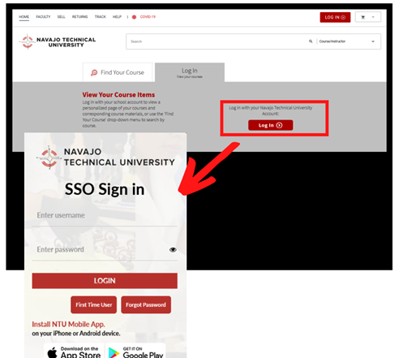
Go to https://navajotech.textbookx.com/.
Log in with your SSO user and password to view your personalized course page.

Slide 3
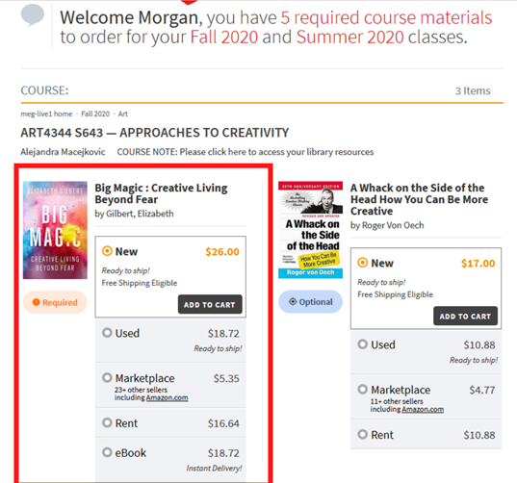
Once logged in, you’ll see your personalized “My Courses” page, which lists all of your registered courses for each semester along with all of the textbooks your professors assigned.

Slide 4
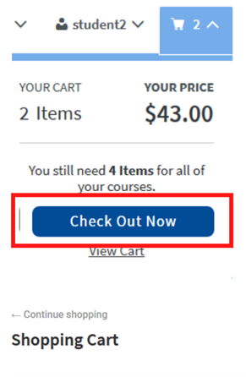
After selecting all the books you want to order, click the cart icon on the top right of the screen and then click “Check Out Now”. Review your order.
NOTE: Please double-check on your order of books. You don’t want to order the same book twice.

Slide 5
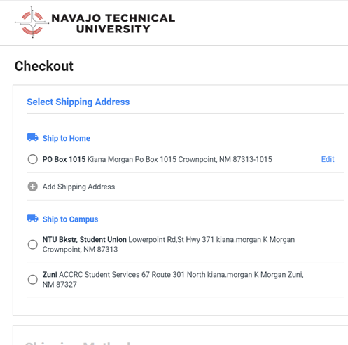
Select Shipping Address:
You can choose to deliver your books at:
Home address
NTU campus address
Add a new address if you would like to deliver to another location.
PO Box 849 Morgan Po Box 849 Crownpoint, NM 87313-0849

Slide 6
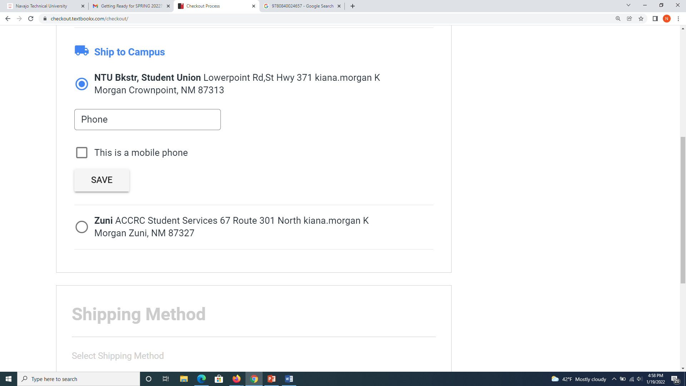
Once you are done selecting a shipping address, it will ask you to enter a phone number and then click “This is a mobile phone” and then click “SAVE.”

Slide 7
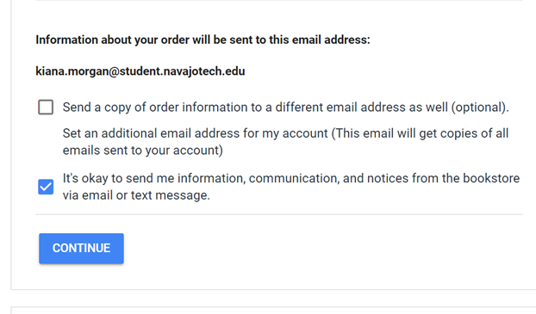
Morgan

Slide 8
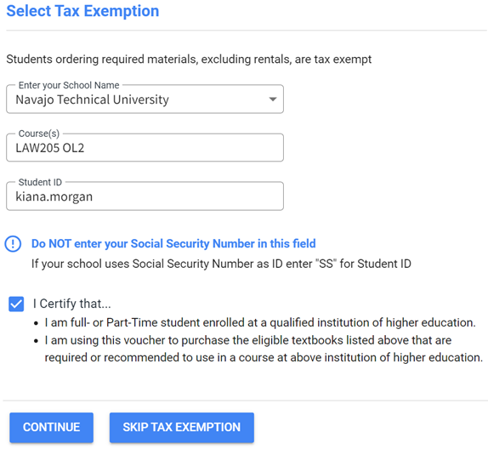
Select Tax Exemption
You will click the box next to “I Certify that…” because:
You are a Full- or Part-Time student enrolled at NTU.
Also, the tax will NOT be added to your order purchase!
Then click, “CONTINUE.”
Morgan

Slide 9
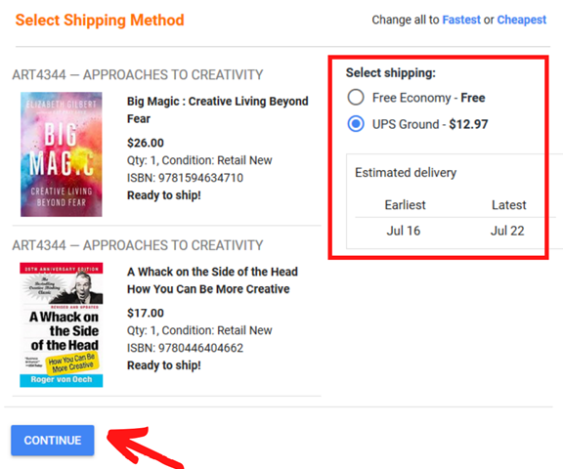
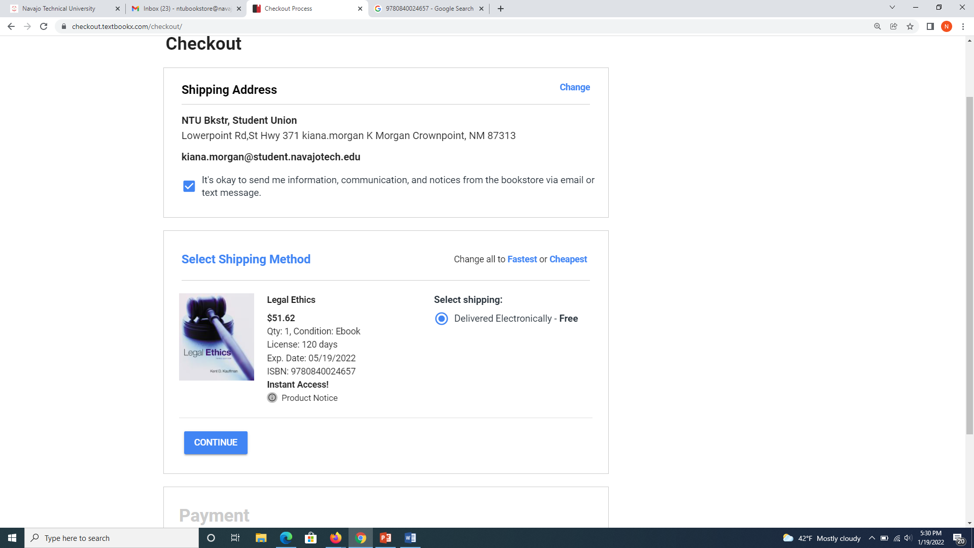

Slide 10
Select Shipping Methods:
For paperback or hardcover books you have a selection of shipping methods with UPS Ground, Free Economy. You will have to choose your shipping cost. The shipping cost will be charged to the school voucher at the end of the check-out process. If you select the Free Economy, it will be free shipping.
For eBook and Access Codes materials, it will be delivered electronically-Free.

Slide 11
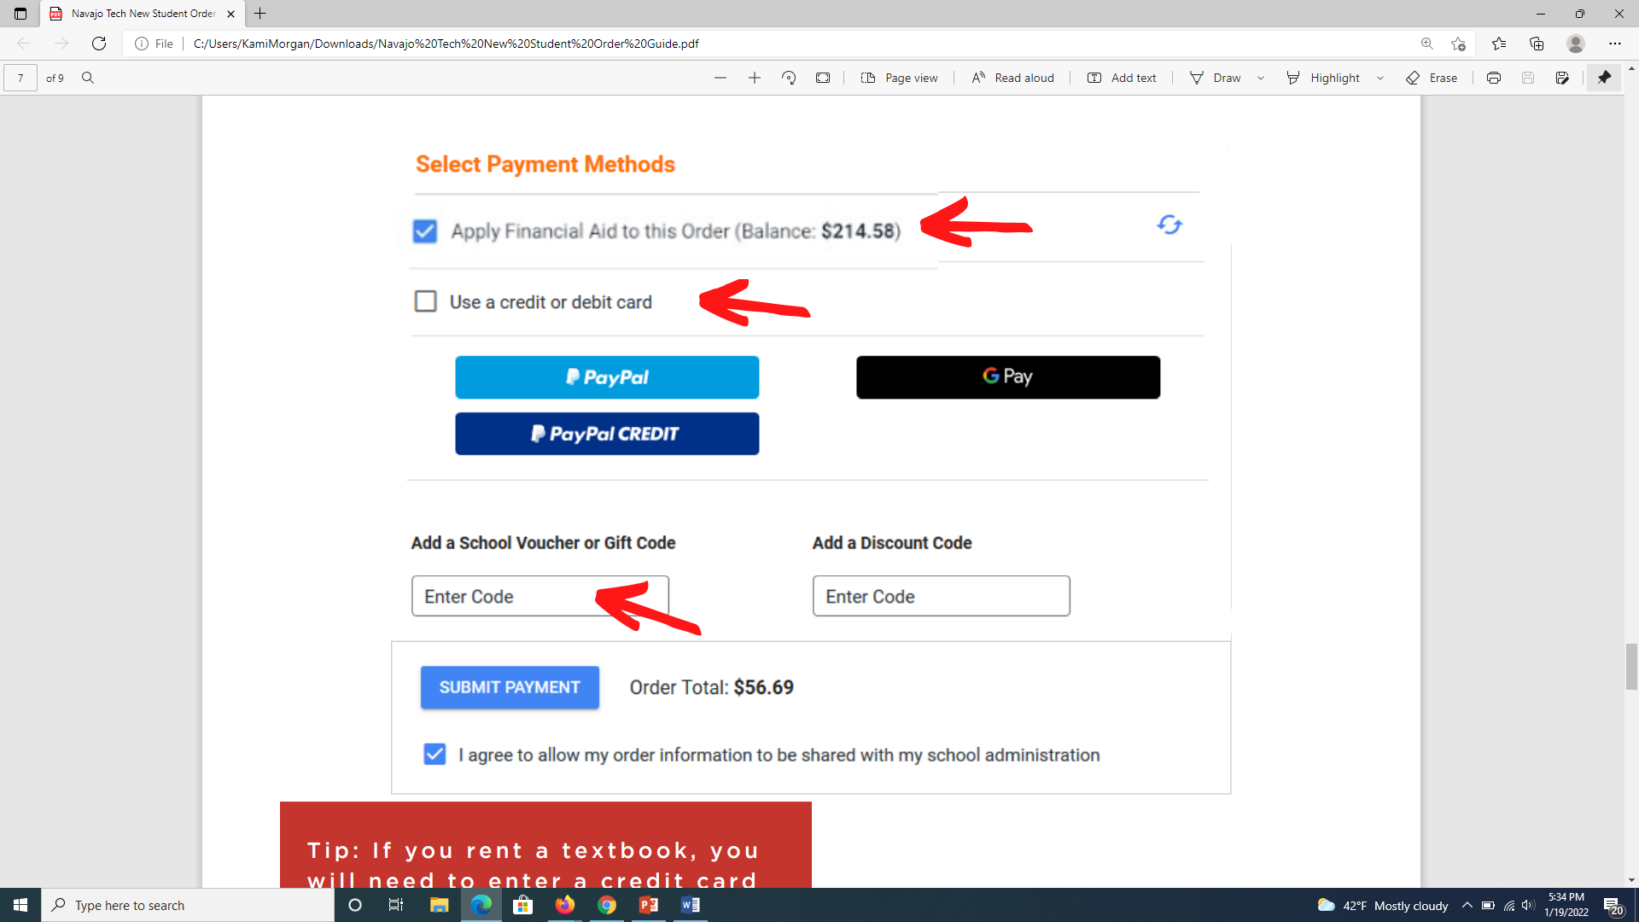
Select Payment Methods:
Students who are eligible for Financial Aid will receive a School Voucher – ($500.00). You can apply for a school voucher, the order total will be charged to your student account.
Or you have an option to enter your credit or debit card information if you are paying on your own.
You won’t need to add a school voucher, gift code, or discount code.
Then, click “SUBMIT PAYMENT.”

