Slide 1
Substance Abuse & Counseling Services
2022 Spring Semester
Hours: 8:00-5:00 (Monday - Friday)
Student Wellness Center, Second Floor Room 214
Cheryll Atine, ICADCII, CCJP
Phone Number: (505) 387-7473
Crisis Services
NTU offers 24/7 Crisis Intervention Services
call (505) 726-3901 to reach the on-call counselor.
Services Offer
Screening and Assessments
Individual Counseling
Adult A&D/DUI Evaluations
Chemical Dependent services
Self-help resources/support
Referrals/Follow-up services
Intervention/Prevention
Trainings
Consultations
Available to consult with concerned faculty, staff, parents, and/or students who are seeking guidance about how to handle a mental health, change of behaviors involving a student.
Student Counseling Services are completely confidential and are for NTU students only.
Student Resources List see NTU Website
Mental Health Crisis Protocol
All services are free of charge

Slide 3
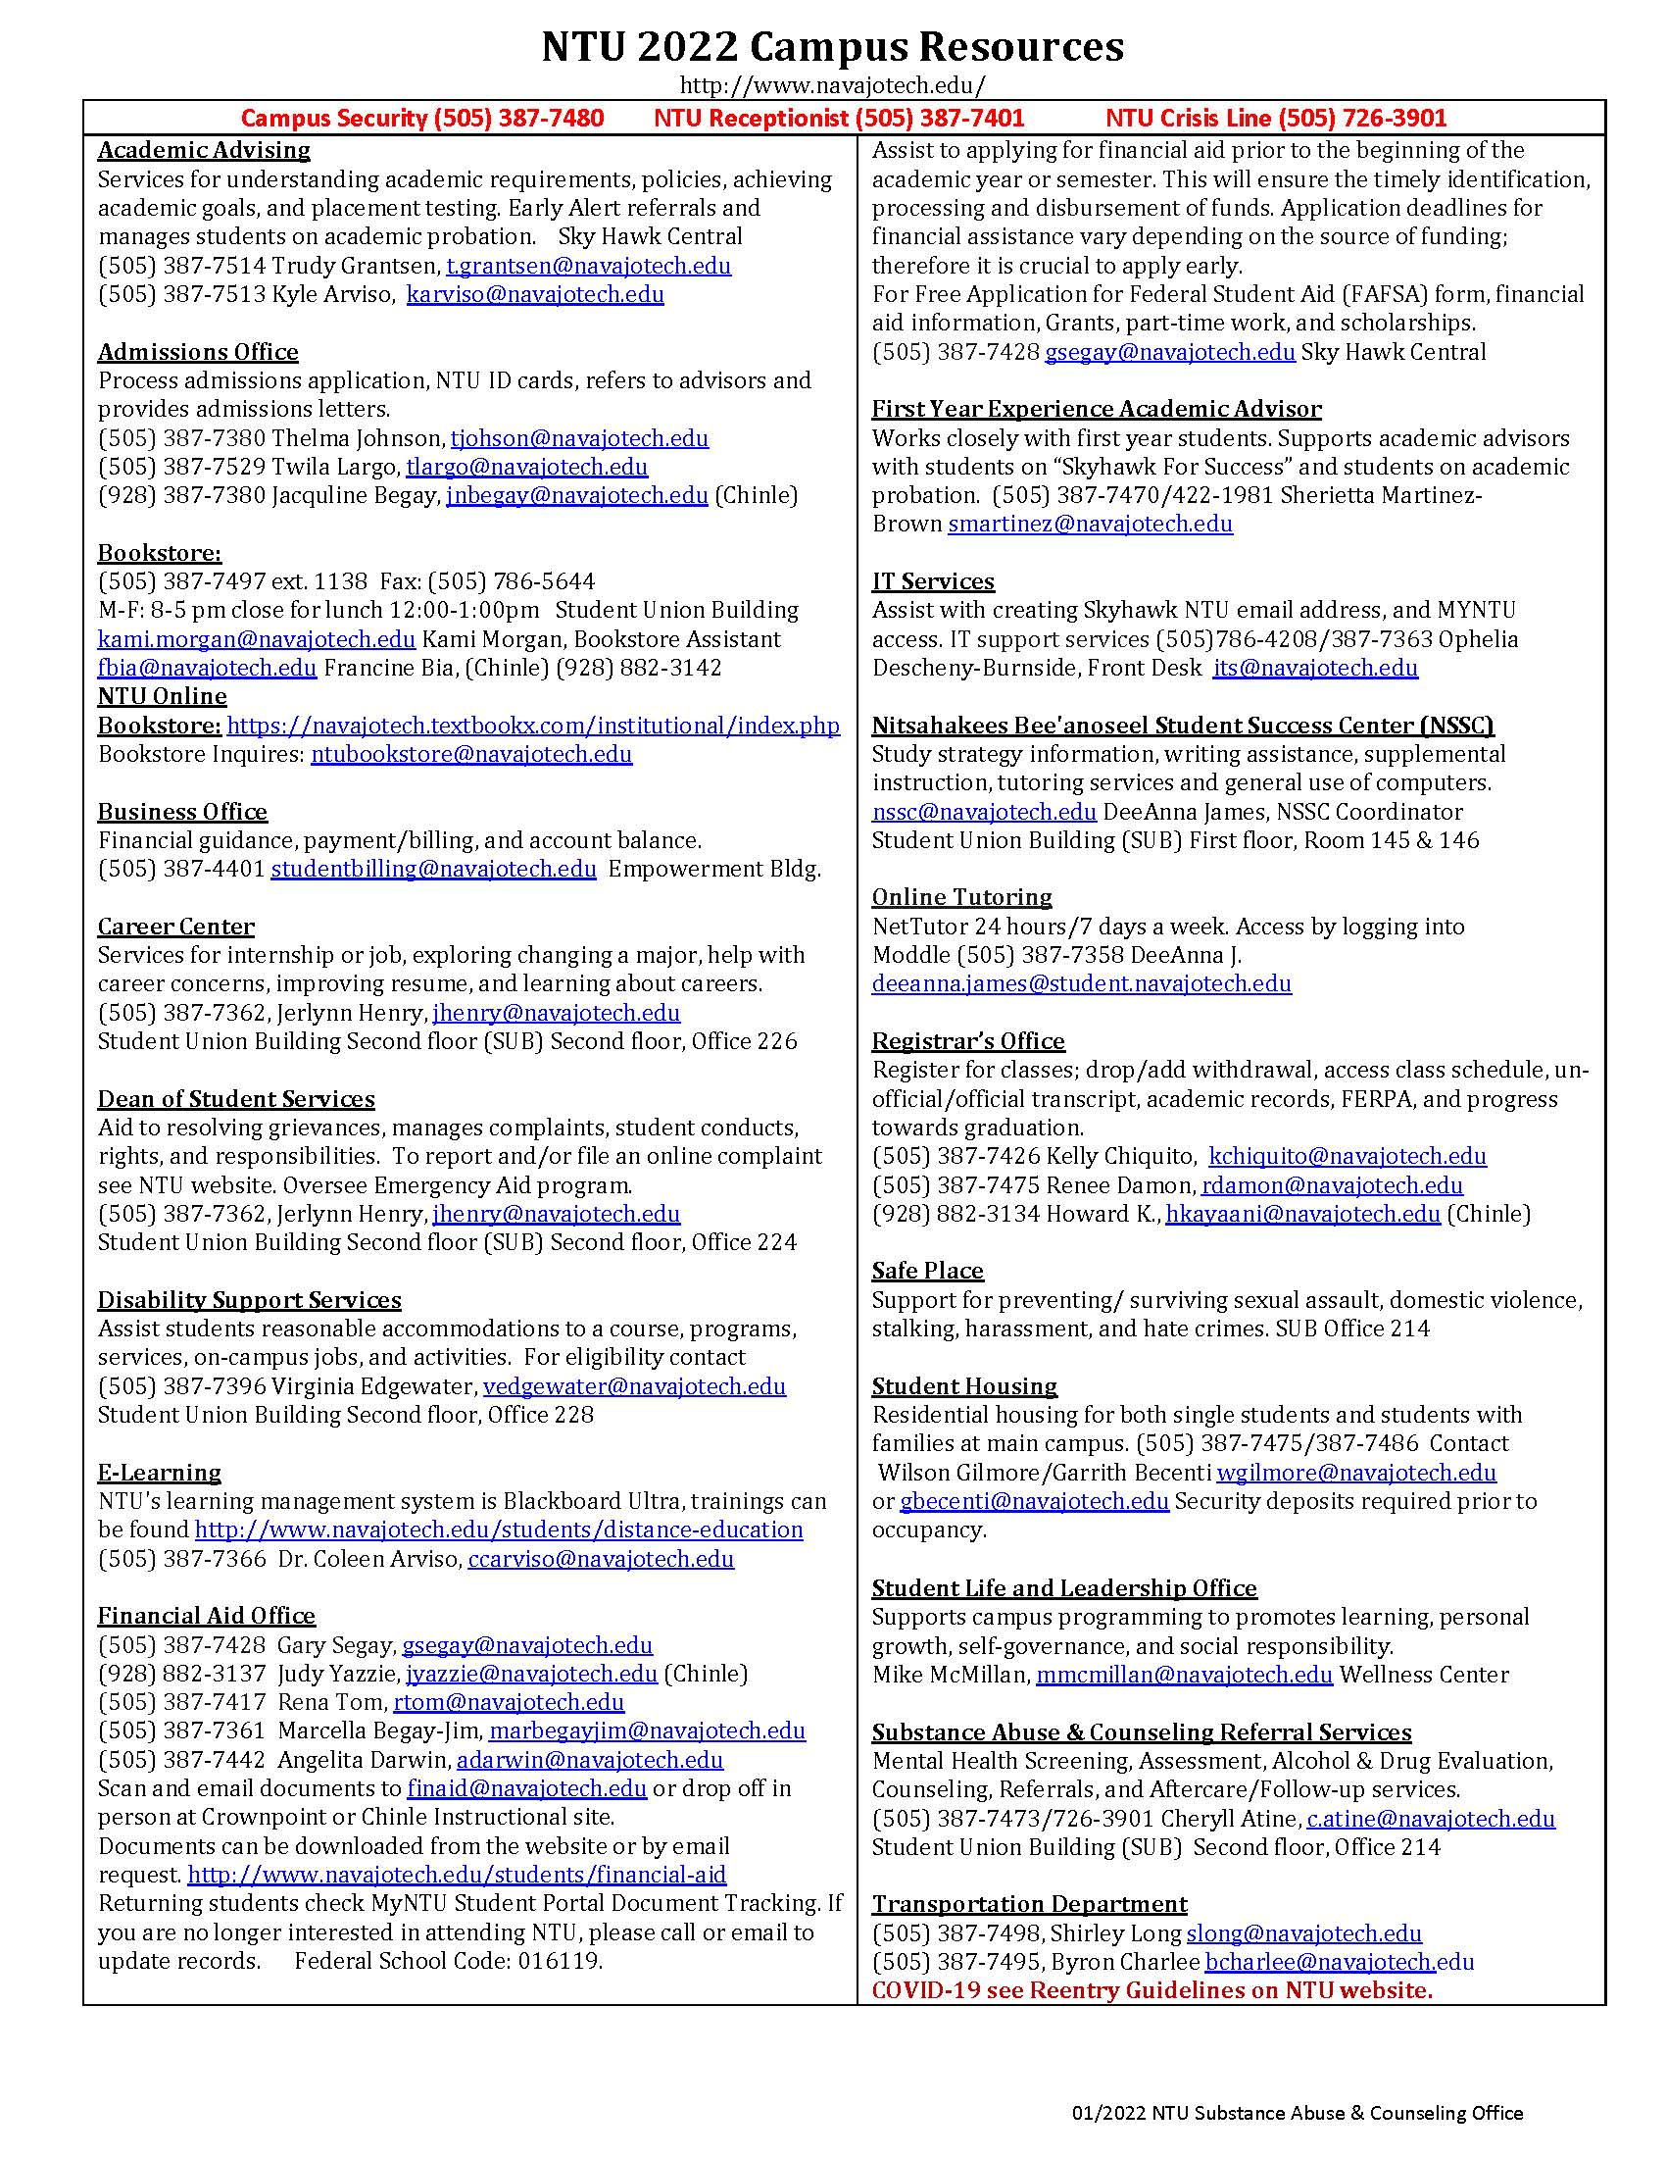

Slide 5
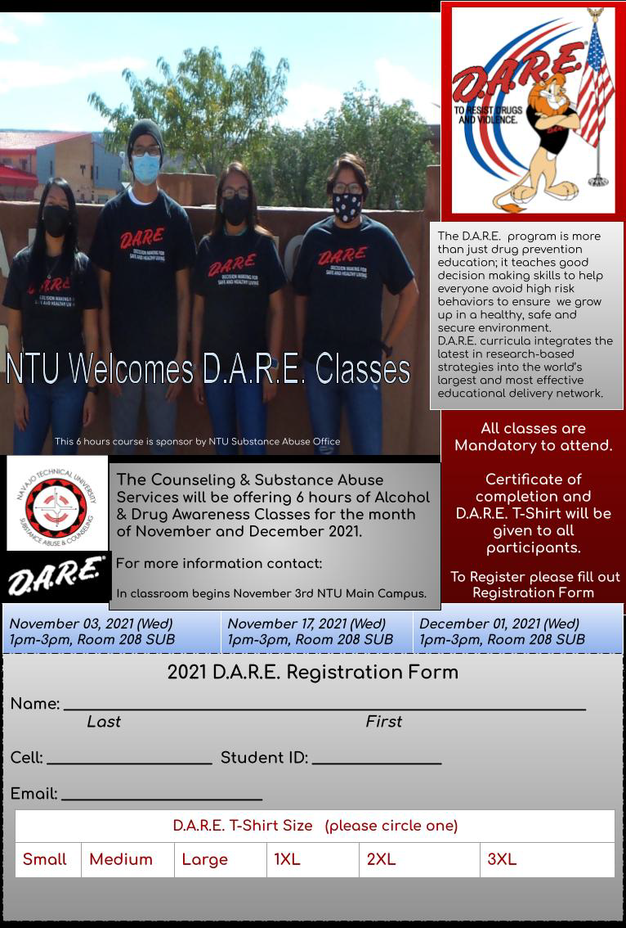
Alcohol & Drug Awareness Classes

Slide 6
Suicide Prevention Gatekeeper Training

Slide 7
Partnerships/ Coalitions/Trainings/
Prevention Efforts
Cheryll Atine, ICADC, IICCJP
c.atine@navajotech.edu
(505) 726-3901

