Slide 1
What is the Purpose of Orientation?

Slide 2
Orientation is the time when we introduce you and welcome you to Navajo Technical University.
Provide a comprehensive information about the academic and student services resources and programs.
Prior to the beginning of classes you’ll learn about the keys to be a successful student, know what is available before you need it.
Guide students in answering all questions they might have.
Get to know the staff and faculty so you know who to turn to for help.
Getting to know those that will be with you from the start of your program to graduation.

Slide 3
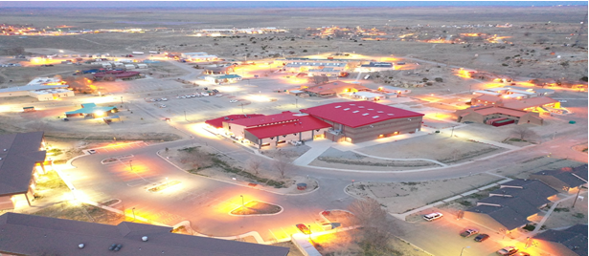
Student Service Department

Slide 4
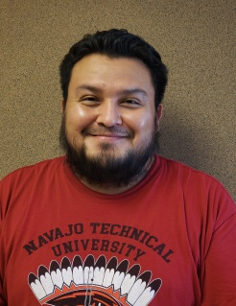




Academic Advisement
& Counseling
Main Campus
Academic Advising, First Year Experience, Academic Counselors focuses on helping each students with:
  Choosing an academic program
  Planning out steps toward graduation
  Solve problems that hinder progress towards an academic goal
  Selecting courses for schedules
  Assist with finding resources or referrals to appropriate department
  Early Alert Programs - interventions
  Academic Progress
Kyle Arviso
Leslie Tsosie
Sherietta Martinez-Brown
Valencia Begay
Chinle Site
Danielita Haskey

Slide 5


Counseling Services
Substance Abuse & Counseling
Accommodations
Tele-Counseling & referrals
substance abuse preventive education for individuals who are experiencing difficulties
Screening for a variety of mental health issues such as anxiety, depression, substance abuse, trauma, family issues, and codependency, relationship, family consultation, trauma informed care, depression, suicidal thoughts and crisis situations.
Chemical dependency
Monitor accommodation agreements
  extra time a student requires to submit homework, quizzes, and tests and the use of recorded devices to submit recorded answers.
Collaboration bewteen instructors and students via laptop, phone text messages/pictures, fax, or by Zoom video platform.
Reasonable Accommodations: Low-tech devices available for students with special needs utilizing, i.e., hearing aid, magnifying sheet, & voice recorder. Free applications (apps) like Screen Readers, Alexicom AAC, and Livescribe are available. Contact staff for access and download the apps. Otherwise, the use of YouTube videos to show how to download apps will suffice.
Cheryll Atine
Virginia Edgewater

Slide 6


Career Services
Provides guidance in selecting a career planning corresponding to your academic program.
Internships
Opportunities for the job market.
Assistance with resume writing, & interviewing techniques.
Andrea Wilson
Career Services Coordinator
Natalie Denezpi
Career & Internship Advisor

Slide 7

Child Care
Child Care Services on campus at a reasonable cost – will reopen until further notice.
Follows a curriculum that promotes development of the whole child.
Laureen Becenti
Child Care Manager

Slide 8


Residential Services
Residential housing for single and family housing.
Full time students and live beyond 55 mile radius.
Security deposits
Taking applications
Will be running at 50% capacity
Wilson Gilmore
Residential Manager
Garrith Becenti
Lead Residential Assistant

Slide 9

NITSÁHÁKEES BEE’ANOOSÉÉŁ STUDENT SUCCESS CENTER
Tutoring Services
Computer lab
Mentorship program
Student Veteran’s Coordinator
Workshops

Slide 10

Bookstore
Inventory of textbooks and school supplies.
Pick up your books! Curbside deliveries.
Books Mailed, send schedules to Jackie Francisco @
  jfrancisco@navajotech.edu

Slide 11

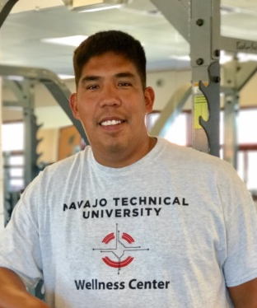
Wellness Center & Student Activities
Wellness Center
Student Activites
Have Rodeo team, Cross Country & Archery
Due to the COVID-19 pandemic the center will continue to be closed until further notice.
  Will follow CDC guidelines when it reopens, limited services
Limited Student activities on and off campus. Majority of events through zoom/ virtual presentation.
Oversee Student Senate & Miss NTU
George LaFrance
Michael McMillan

Slide 12
NTU STUDENT ASSISTANCE

Slide 13
Available Assistance
Emergency Aid
  Portal will open February 1, 2021
Gas Cards
  Still on order – available once they come in
Laptop/Mifi checkout
  Call the IT Department or email its@navajotech.edu

