Slide 1
New student orientation
Team ntu welcomes you to spring 2021

Slide 2
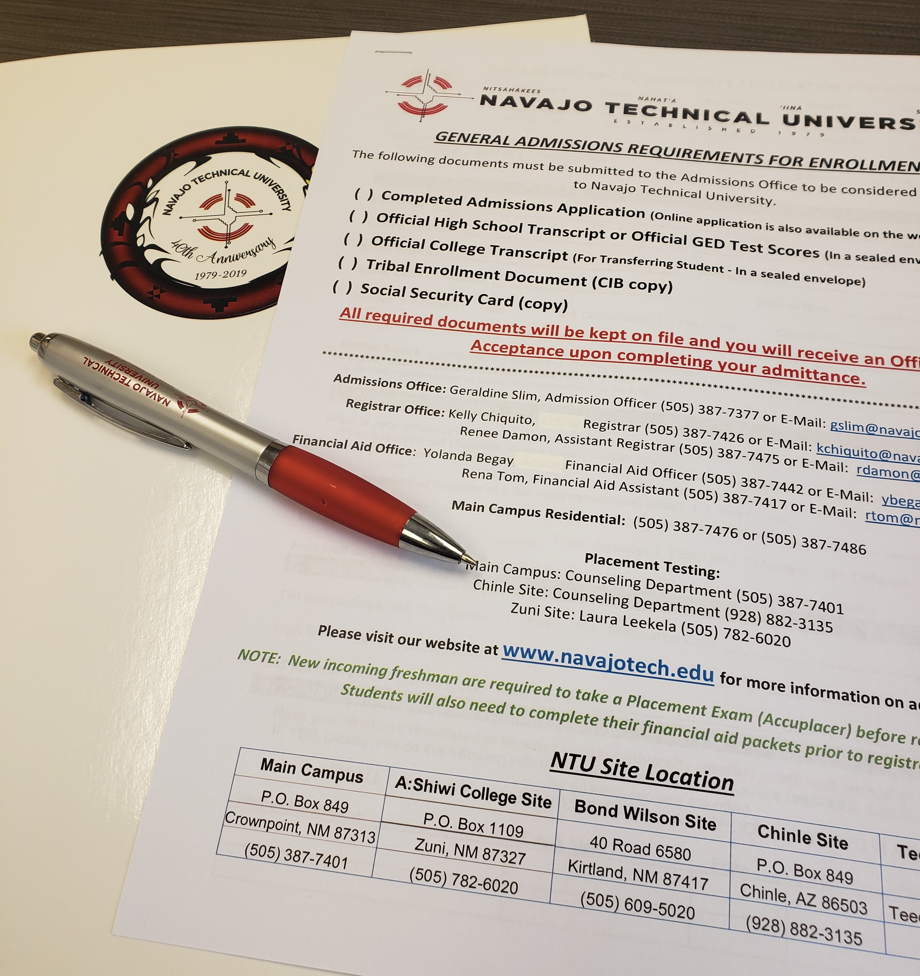
Welcome to the Skyhawk family!
meet the advisors
Advisors?
  Academic
  program

Slide 3
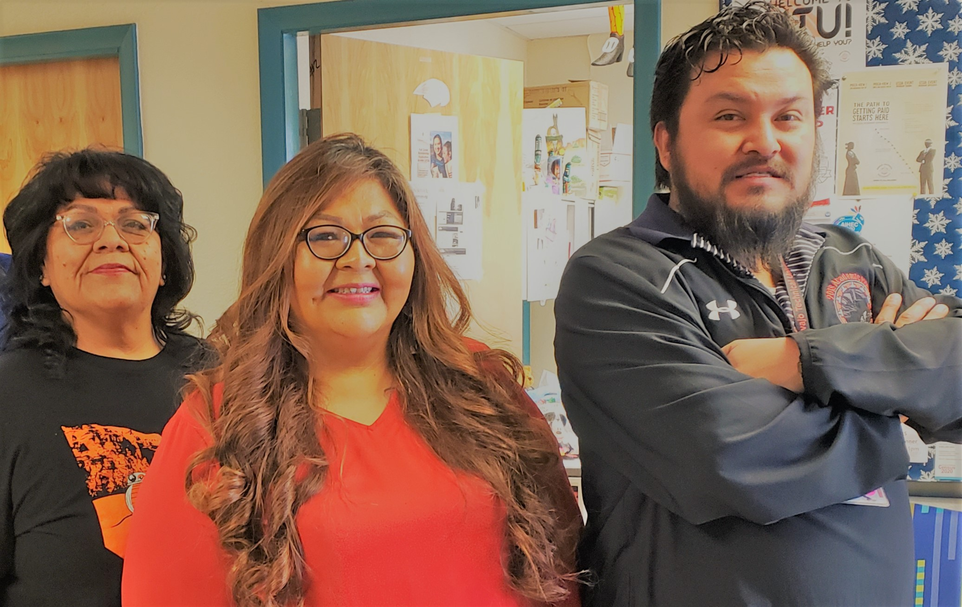
Main campus advisors
Leslie Tsosie, academic advisor
Sherietta Martinez-brown, first year experience career & academic advisor
Kyle arviso, academic advisor

Slide 4
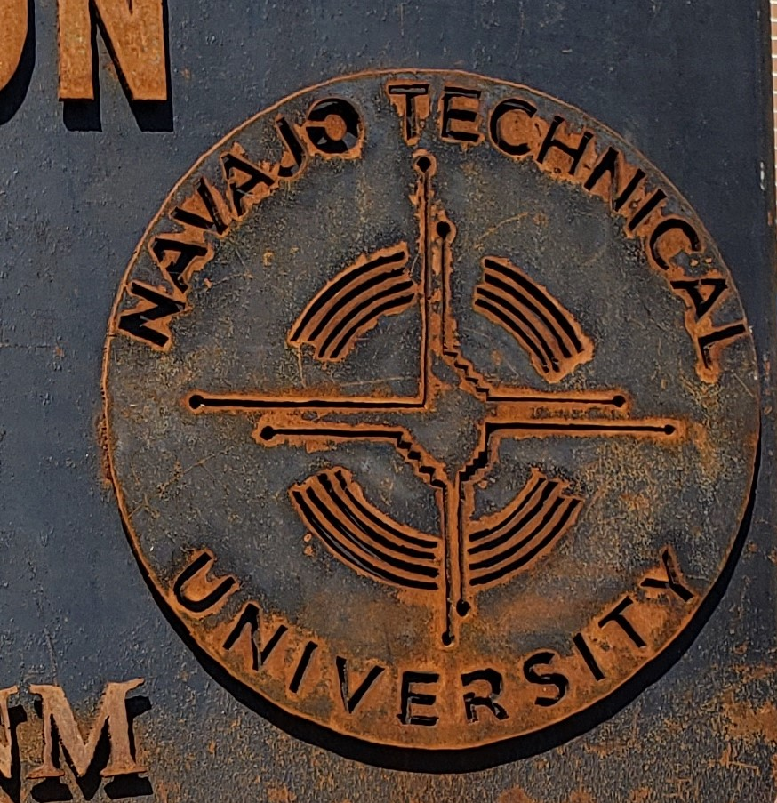
Instructional site advisors
Chinle & teec nos pos site: Valencia Begay, Academic Counselor and danielita haskey, academic advisor
Zuni site: bobbie shack, director of student services
Bond Wilson site: dr. vangee nez

Slide 5

Academic advisor
“Key contributor to student success”
“Attend to student academic inquiries”
“advises and assists students in the development of academic plans and class schedules”

Slide 6
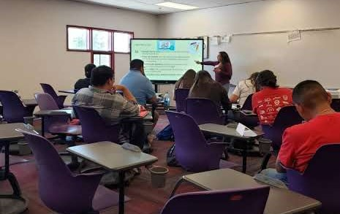
objective
Provide
support

Slide 7
What kind of support?
HELP STUDENTS FEEL WELCOME TO OUR CAMPUS
ENCOURAGE STUDENTS TO EXPLORE OUR SERVICES & RESOURCES
ENCOURAGE STAFF & FACULTY TO HELP STUDENTS IDENTIFY HOW TO ADAPT TO OUR NTU FAMILY

Slide 8
7 R’S OF SUCCESS
RELATIONSHIPS- Surround ourselves w/respect
Resources- increase progress & connections
RELEVANCE- evaluate experiences
RAINBOWS- give voice
Reflection- frequency → what, how and who we do it for
RESPONSIBILITY- ownership of success
RESILIENCE- retention→ graduation→career

Slide 9
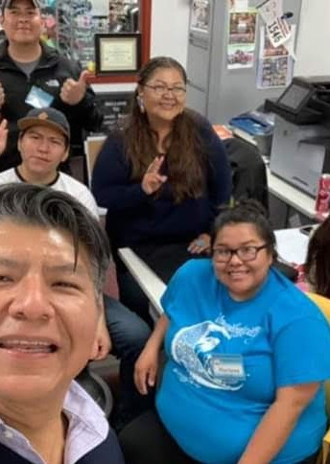
What is our number one institutional resource?
S t u d e n t s

Slide 10

What do we expect from our students?
Interacting
commitment
Self discipline
Embracing your identity

Slide 11
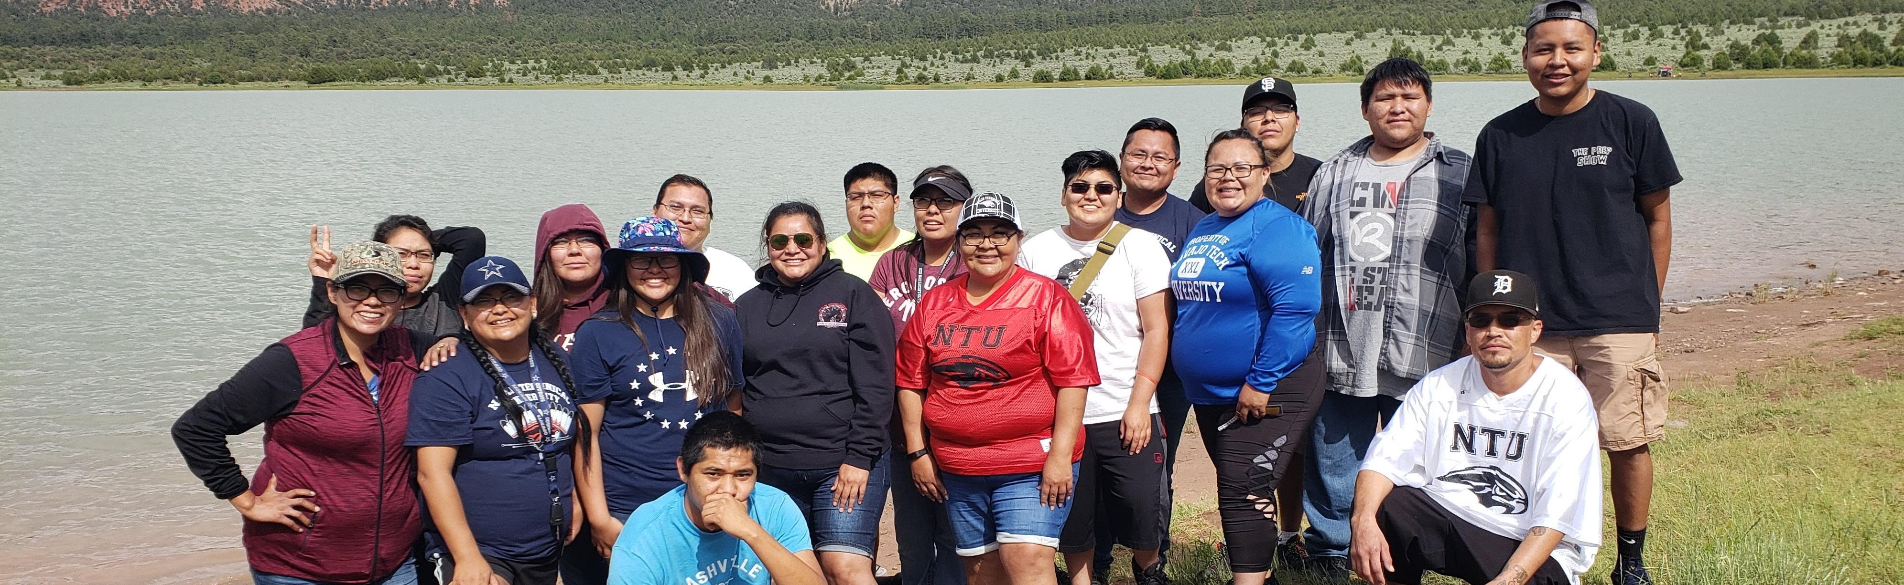
What do they expect from us?
Students expect us to listen, guide and assist them to complete their academic journey.

Slide 12
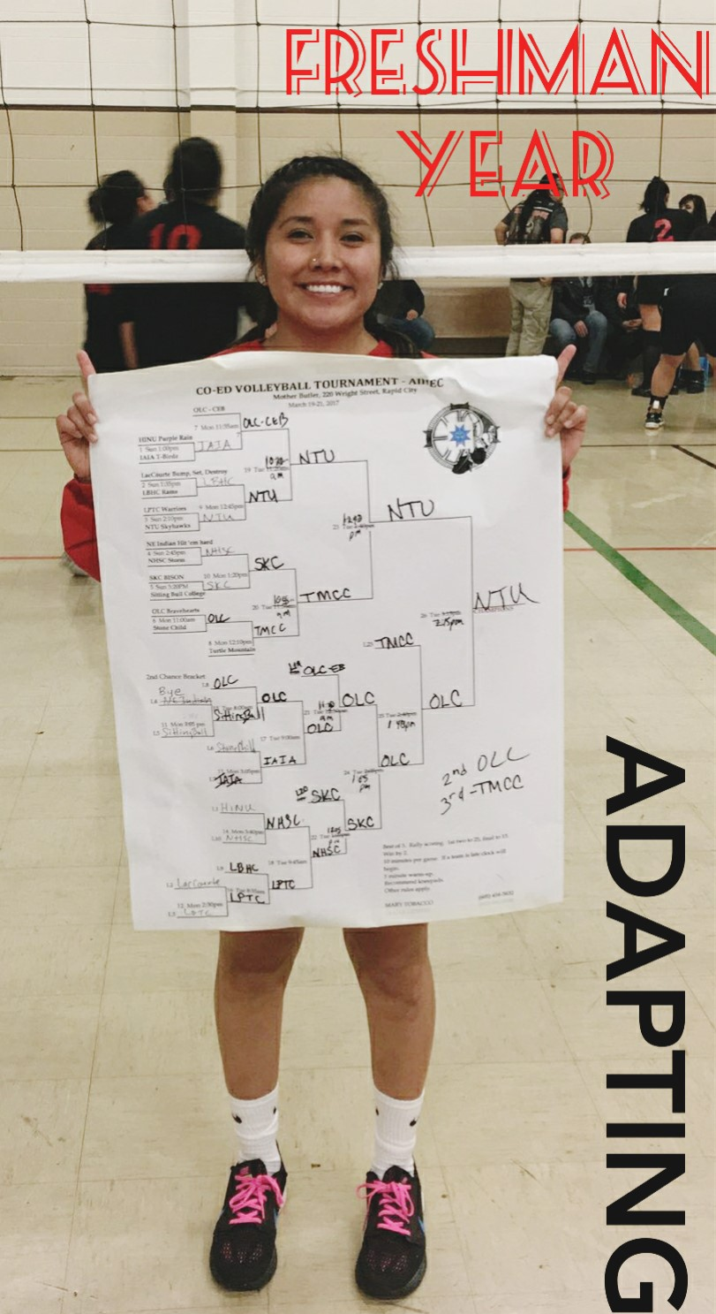
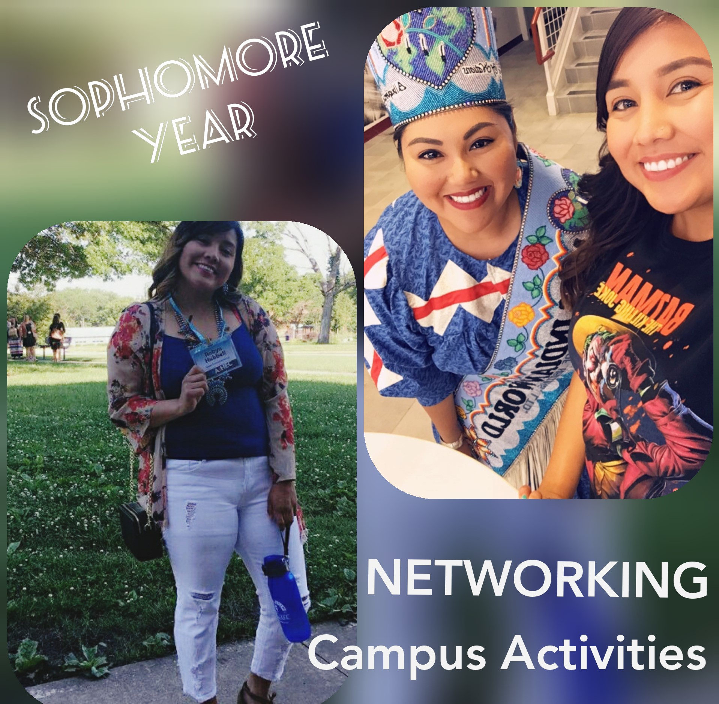


Plan for the best outcome
Adapting
Transitioning
Self actualization
Self discipline
Career planning
Personal growth
Professional growth

Slide 13
Student success
directions
guidance
support
Outreach to students
Academic advisors
Ntu faculty
Financial aid
Social media
Covid 19
Online learning experiences
Moodle training student/staff
Library resources
Cengage training
Student services- counseling/accomodations
Student life

Slide 14
Let’s have a great semester!
questions
Concerns
Complaints…..

