Slide 1
FERPA & NTU Policies
Presented By
Dr. Delores Becenti
Director of Enrollment Services

Slide 2

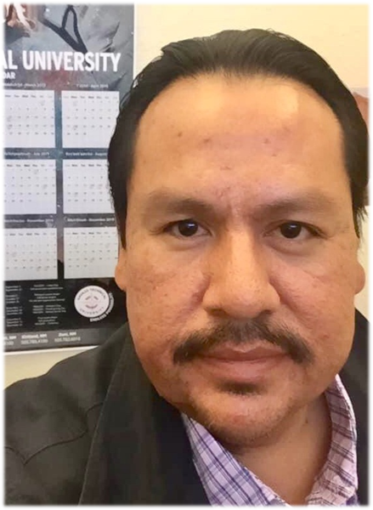
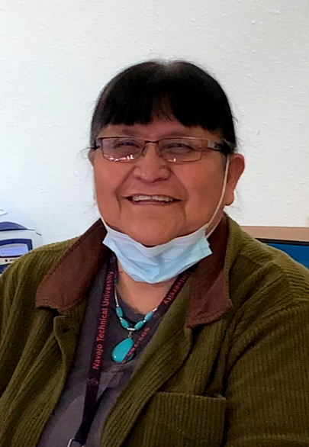
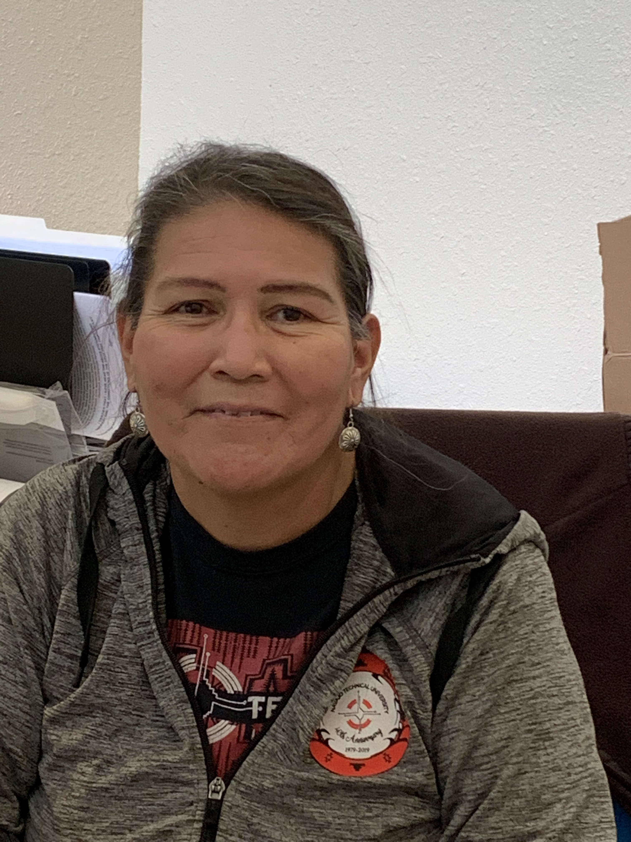
ENROLLMENT STAFF
CHINLE:
Howard Kayaani
Registrar Asst.
928/882-3134
hkayaani@navajotech.edu
Jacqueline Begay
Admission Officer
928/882-3143
jnbegay@navajotech.edu
Dr. Delores Becenti Director of Enrollment Services
Kelly Chiquito
Registrar
Renee Damon
Asst. Registrar
Thelma Johnson
Admission Asst.

Slide 3
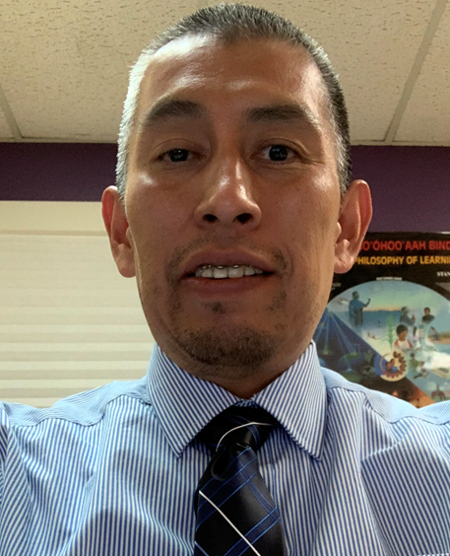


Financial Aid Staff
CHINLE:
Judy Yazzie
Financial Aid Asst.
928/882-3137
jyazzie@navajotech.edu
Gary Segay
Financial Aid Manager
Yolanda Begay
Financial Aid Technician
Rena Tom
Financial Aid Asst.

Slide 4
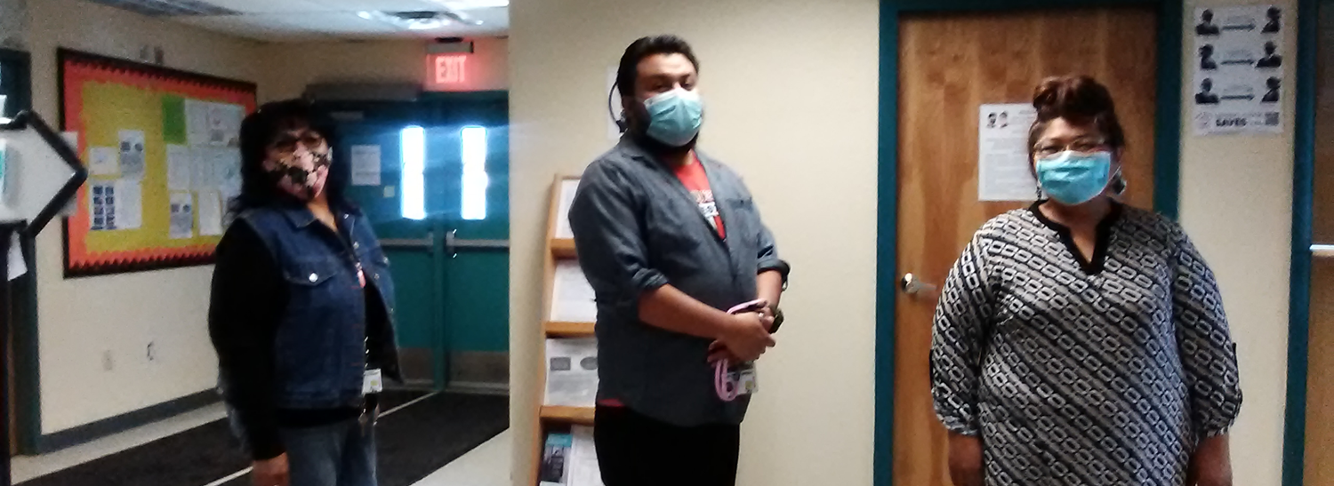
Leslie Tsosie Kyle Arviso Sherietta Martinez-Brown
Academic Advisor Academic Advisor First-Year Students Advisor
CHINLE: Danielita Haskey, Academic Counselor
Valencia Begay, Academic Counselor

Slide 5
Registration Process

Slide 6
FERPA
Family Educational Rights and Privacy Act of 1974
[Federal Policy]

Slide 7
What is FERPA?
Protects the privacy of a student’s educational records by establishing the right of students to inspect their records; and
Providing guidelines for the correction of inaccurate or misleading records; and
Protects student’s privacy while enrolled at NTU; and
FERPA applies to all schools that receive funds under U.S. Department of Education programs (such as PELL).
Page 12 of the NTU undergraduate catalog.

Slide 8
FERPA allows schools to disclose those records, without consent, to the following parties or under the following conditions (34 CFR § 99.31)
School officials with legitimate educational interest;
Other schools to which a student is transferring;
Specified officials for audit or evaluation purposes;
Appropriate parties in connection with financial aid to a student;
Organizations conducting certain studies for or on behalf of the school;
Accrediting organizations;
To comply with a judicial order or lawfully issued subpoena;
Appropriate officials in cases of health and safety emergencies; and
State and local authorities, within a juvenile justice system, pursuant to specific State law.

Slide 9
NTU Directory Information (available to the public without student’s consent)
Name, address, email address, telephone listing, date and place of birth;
Dates of attendance and graduation, degrees and awards received, grade level or year (such as freshman or junior), and enrollment status (undergraduate or graduate; full-time or part-time);
Participation in officially recognized activities and sports, weight and height of members of athletic teams; and
Videotapes or photos of students participating in NTU activities

Slide 10
If a student does not wish to have this information released:
A request for non-disclosure of directory information must be submitted in writing to the Admissions/Registrar’s Office.
This request must be submitted by the student within the first two weeks of their first semester.
Valid until the student withdraws their request for non-disclosure by providing written authorization for the release of that information.

Slide 11
Students have the right to examine their official file.
Requests to examine student records should be scheduled in advance with, and performed under, the supervision of the Registrar.
The student must submit a written request to the Registrar requesting the documents to be reviewed and indicating which documents are to be reviewed
Students may submit a written request to the Registrar to amend a record that is believed to be inaccurate or misleading.

Slide 12
Filing a Complaint for FERPA Violation
FERPA complaint:
Be in writing and must contain specific allegations of fact giving reasonable cause to believe that a FERPA violation has occurred; AND
Filed within 180 days of the alleged violation or within 180 days after the complainant knew or should have known about the violation.
NOTE: If under the age of 17 - filed by the parent of the student.

Slide 13
Address to File
Students have the right to file complaints with the Family Policy Compliance Office of the U.S. Department of Education concerning any alleged failures by NTU to comply with FERPA.
U.S. Department of Education
Student Privacy Policy Office
400 Maryland Ave, SW
Washington, DC 20202-8520

Slide 14
NTU Catalog Provides
Descriptions of courses and programs that will guide you toward earning the certificate or degree you want to earn.
Provides admission, registration, financial aid, and academic policies
Provides calendar, staff/faculty information and credentials.
Tuition and fees.

Slide 15
NTU Academic Policies
Academic Integrity – Honesty. Doing your own work.
Plagiarism is a Violation – Using someone else’s work without acknowledging or citation. Possible Dismissal from NTU.
Attendance – Student’s responsibility to attend all classes. Included in Percentage of grade. (Some instructors may drop a student after 3 absences. )
Early Alert – Notification to Advisors/Counselors for early intervention of a student’s academic issues.

Slide 16
Credit Hour Calculation
One credit hour = 800 minutes per credit per semester.
(Ex: 3 credit hour course = Minimum 2.5 hours per week for 16 week semester)
One lab semester hour = 1600 min. per credit per semester.
(Ex: 1 credit hour lab = Minimum 1.7 hours per week for 16 week semester)
Note: More condensed for summer and intersessions.

Slide 17
Expectations Outside of Classroom
For face-to-face - one credit hour spent in class, a student is expected to spend two hours outside of class studying the course materials.
For a hybrid or blended course of one (1) credit hour, a student is expected to spend three (3) hours per week studying the course materials.
For an online course of one (1) credit hour, a student is expected to spend four (4) hours per week studying the course materials

Slide 18
Courses
Course Withdrawal – Student or Instructor initiated – Deadline on Calendar
Course Repeat - Repeat a course and to have the grade for the repeated course computed in student’s GPA in place of the original grade. Grade of “W” not permitted. Original grade will be replaced with “R”.
Course Substitution - Under certain circumstances, substitutions for required courses may be necessary and appropriate. Same course description. Approved by Dean of Instruction. Form submitted to Registrar.

Slide 19
Courses (continued)
Course Load – 1 to 11 credit hours is PT; 12 & over credit hours is FT
Summer enrollment 6 credit hours is FT (Financial Aid 12 credit hours is FT)
Overload - 16 & over is Overload (need permission by Dean)
Independent Study – Approved by Instructor and Dean
(Eligibility - 2.5 or higher GPA. No more than 6 credit hours in one semester allowed for Independent Study.)

Slide 20
Grades
Midterm Grades – Progress at midterm. Unofficial
Final Grades – Official grade at the end of the term
Incomplete Grade – Instructor initiated – submit form to Registrar – Allowed one semester to complete otherwise grade will be converted to “F”
Grade Appeal Procedure
Appeal Form > Dean of Instruction > Committee/Investigation >
Decision to Dean of Instruction (Final) > Student (Copy to Registrar)
Grade Change – Initiated by instructor – Submit signed form to Registrar

Slide 21
Academic Standing Satisfactory Academic Progress
Good Standing – CGPA is 2.00 or higher
Academic Probation – CGPA is 1.99 or below at the end of the semester.
(Student will be placed on Probationary Contract and Financial Aid Probation)
Continuing Academic Probation – CGPA remains 1.99 or below the following semester.
(Student will continue on Probationary Contract and Financial Aid Probation)
Academic Suspension – CGPA remains below 1.99 after the Continuing Academic Probation.
(Student will have to stay out one semester and request for readmission to Registrar.
Student will be ineligible for financial aid. Pay out of pocket)
Appeal Procedure – Students may appeal (in writing) to the Dean of Instruction within 10 working days of postmark of letter from Registrar.

Slide 22
Graduation Eligibility
To be eligible for graduation and participation in commencement exercise, students must meet the requirements for a degree or certificate.
Meet with advisor to complete Petition to Graduate and Program Checklist.
Submit Petition with all required signatures to Graduate to Registrar’s Office by Deadline Registrar will audit the Petition and notify student of status/eligibility.
Student will be responsible to pay all outstanding accounts with NTU.
Student must return any equipment, books, etc. that are NTU property.
Commencement = Graduation ceremony is conducted end of Spring and Fall semesters.

Slide 23
Other NTU Policies (Student Handbook p. 42)
N.T.U. Weapons Policy – Zero Tolerance
Alcohol and Drug-Free Policy
Search and Seizure Policy
Tobacco-Free Campus Policy
Sex Discrimination Policy
Student/Staff Relationships (Fraternization)
Other Prohibited Conduct (page 51)

Slide 24
CONTACTS
Delores – 505/387-7404 d.becenti@navajotech.edu
Kelly – 505/387-7365 kchiquito@navajotech.edu
Gary – 505/387-7428 gsegay@navajotech.edu
Kyle – 505/387-7513 karviso@navajotech.edu
Leslie – 505/387-7514 ltsosie@navajotech.edu
Sherietta – 505/387-7470 smartinez@navajotech.edu

