Slide 1


Slide 2


Career Services Staff
Andrea Wilson, Career Services Coordinator
bit’ahnii (Folded arm People) nishlí dóó Kinyaa’anii (Towering House people) báshíshchíín;
Ta’neezahnii (Tangle Clan) éí dashicheii dóó ‘'Ashiihi (Salt People) éí dashinálí.
Natalie Denezpi, Career & Internship Advisor

Slide 3
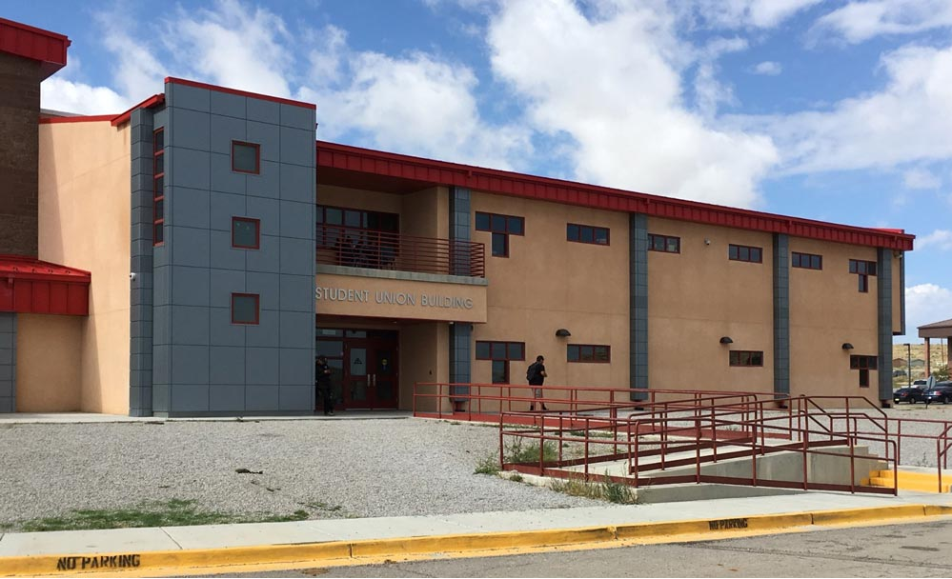
SERVICES OFFERED
Resume Development
Drafting Letters of Interest
Letter of Recommendations
Effective Goal Setting
Academic Internships
Paid Internships
Mock Interviews (by appointment only)
Job & Internship search
Mentorships program
Weekly information sheet that provides job announcements, internship opportunities and community events.
Alumni services up to 3 years after graduation

Slide 4
Academic Internship
All academic internship’s are done at the end of each students degree plan. The academic internship does not pay the student, but the student will gain an academic credit to complete their certificate or degree.
The student will do 150 hours of onsite job training at their choice of worksite.
Academic Internship Application Process
Check with program supervisor or advisor to see if you are eligible for the internship.
Fill out a Internship policies and procedures. It is an agreement between the student, employer and program supervisor that the student can complete their internship with their chosen location.
Seek out employers to complete 150 hours of onsite job training. (The Office of Career Services can assist with finding an employer.)
The Office of Career Services staff will then review the policies and procedures, contact the program supervisor and employer to secure the internship. A timesheet will be sent out to the employer to record the students hours.
The end of the internship the student and employer will be given an evaluation and this shall be submitted to the Office of Career Services staff.
The grade will then given to the students by the program supervisor.

Slide 5
Paid Internships
To qualify students must meet the following requirement:
Must be Enrolled in a degree seeking program for the Spring of 2021.
Work no more than 20 hours per week.
Complete a student application with all required documents.
Students employment must coincide with the student’s degree of study.
Internships are a valuable way to gain professional experience or learn more about a profession you are interested in. The many benefits of an internship include developing strong teamwork skills, learning to work independently, applying what you learn in the classroom to real world situations, and making yourself competitive in the job market

Slide 6

Career Services Employment Expo
The Office of Career Services has been hosting semester Employment Expo since 2017. Over the years the employment expo’s have been helping NTU students find employment, internship and paid internships.
The event would have been a two-day series of professional development. Day one is the workshop day that would consist of presentations on resume development, letter of interest review, and tips on career building. The second day would be a career fair that would house 50 plus business from all over the Navajo nations to recruit NTU students for employment or internship based opportunities.
Due to COVID-19 & in respect of the CDC guidelines the Office of Career Services would like to host a safer and well organized career fair by providing NTU’s very first virtual career fair.
The next employment expo will be hosted in the month of March 2021.

Slide 7
CONTACT US
Andrea Wilson
Natalie Denezpi
Email: awilson@navajotech.edu
Phone: 505-387-7372
Office Location: SUB 226
careerservices@navajotech.edu
Email: ndenezpi@navajotech.edu
Office Location: Room SUB #222

