Slide 1
Meal PLans
Lorena Giesbrecht

Slide 2
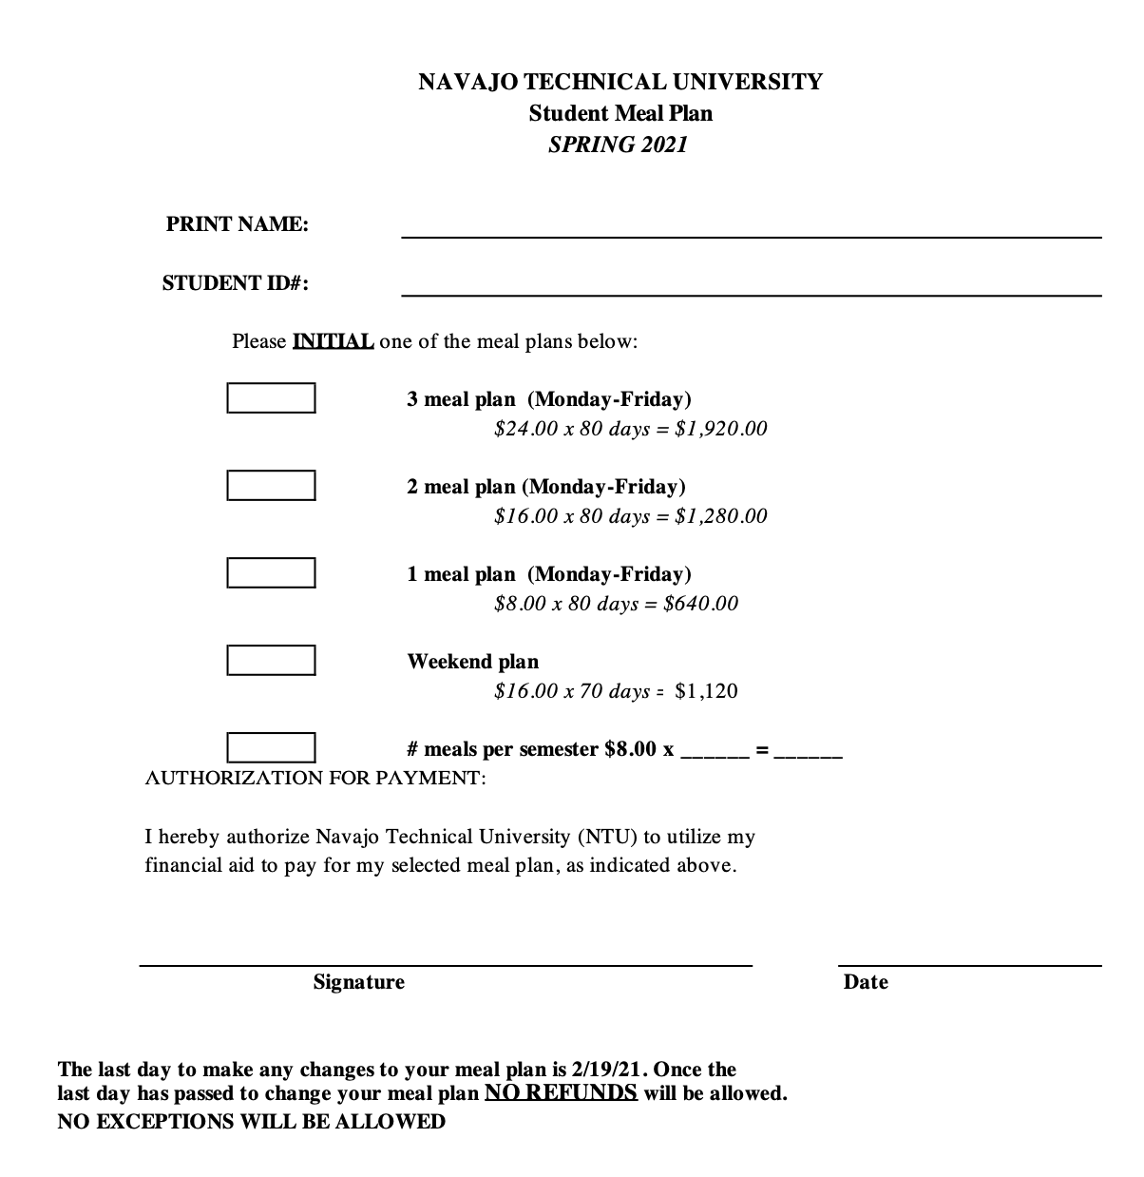

Slide 3
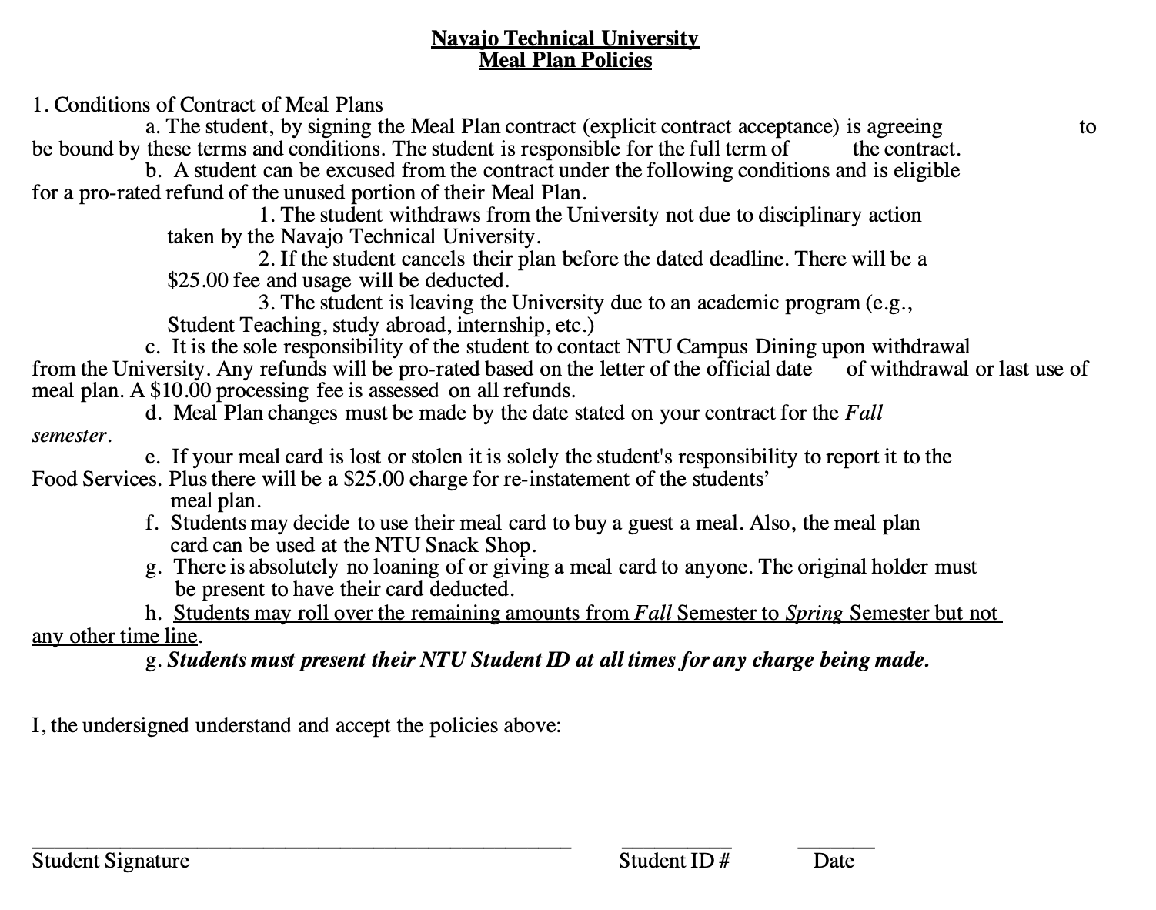

Slide 4
Cancellation Policy

Slide 5
Rollover policy

Slide 6
Things to know
To sign up for a meal plan you must go to the cafeteria
Meal card balances are displayed on your receipt when purchasing a meal or a snack from the snack shop
You can also get your balance by asking Cafeteria or Snack Shop staff.

